Slide 1
JavaScript Day6
JS
Presented By : Asmaa Ahmed

Slide 2
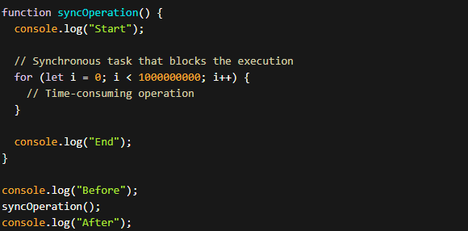
difference between asynchronous (async) and synchronous (sync)?
Synchronous Operations:
In synchronous operations, each task is executed one after the other in a sequential manner. The program waits for each task to complete before moving on to the next one. This means that if a task takes a long time to complete, it can block the execution of subsequent tasks, causing the program to appear unresponsive.

Slide 3
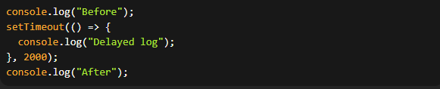
difference between asynchronous (async) and synchronous (sync)?
Asynchronous Operations:
In asynchronous operations, tasks are initiated, but the program doesn't wait for each task to finish before moving on to the next one. Instead, it continues executing other tasks while waiting for the asynchronous operations to complete. This allows for more efficient utilization of resources and a more responsive user experience.

Slide 4
AJAX
Ajax (Asynchronous JavaScript and XML) is a technique used in web development to create asynchronous web applications. It allows you to update parts of a web page without reloading the entire page, providing a smoother and more responsive user experience.
Ajax combines several technologies, including JavaScript, XML (although nowadays JSON is more commonly used), HTML, CSS, and XMLHttpRequest (XHR) objects. The XMLHttpRequest object is used to exchange data with a web server asynchronously, without interfering with the display and behavior of the existing page.
XMLHttpRequest object is created, and a callback function is defined to handle the server response. The open method is used to specify the HTTP method (GET, POST, etc.) and the URL to send the request to. Finally, the send method is called to initiate the request.
Ajax can be used in various scenarios, such as retrieving data from a server, submitting form data, updating content dynamically, and more. It is particularly useful when you want to enhance the user experience by making web applications more interactive and responsive.

Slide 5
AJAX
Asynchronous Communication: Ajax allows for asynchronous communication between the client (web browser) and the server. This means that the client can send a request to the server and continue to work with the page while waiting for the response. This asynchronous nature avoids blocking the user interface and provides a smoother browsing experience.
XMLHttpRequest (XHR) Object: The XMLHttpRequest object is the foundation of Ajax. It provides methods and properties to send HTTP requests to a server and handle the server's response. You can use the XHR object to make various types of requests, such as GET, POST, PUT, DELETE, etc., and send data along with the request.
Cross-Origin Resource Sharing (CORS): Due to security restrictions, Ajax requests are subject to the same-origin policy, which means that a web page can only make requests to the same domain it was loaded from. However, with CORS, it is possible to make Ajax requests to different domains by allowing the server to specify which domains are allowed to access its resources.
JSON (JavaScript Object Notation): Although XML was originally part of Ajax's name, JSON has become the preferred data format for exchanging data between the client and server. JSON is a lightweight data interchange format that is easy to parse and generate in JavaScript.

Slide 6
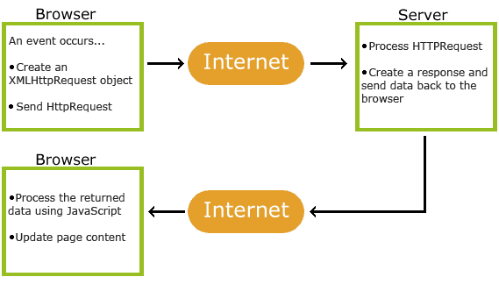
AJAX
Ajax Frameworks and Libraries: Several JavaScript frameworks and libraries simplify working with Ajax. Some popular ones include jQuery, Axios, Fetch API, and AngularJS. These frameworks provide higher-level abstractions and utility functions to handle Ajax requests more conveniently.
Error Handling and Callbacks: Ajax requests can encounter errors, such as network failures or server-side issues. To handle these errors, you can define error callbacks that will be invoked if the request fails. Additionally, you can define success callbacks to process the server's response when the request is successful.

Slide 7
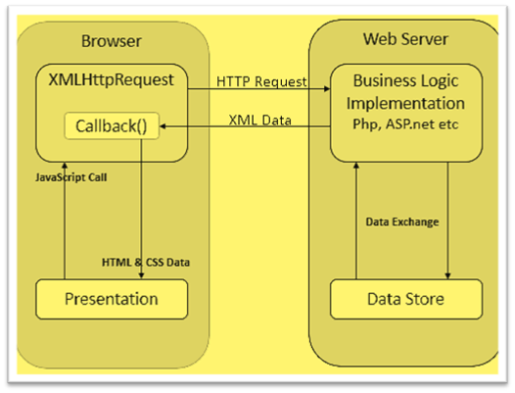
AJAX

Slide 8
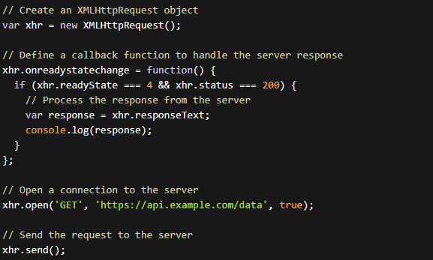
AJAX Example
Example

Slide 9
why Ajax is used in web development?
Dynamic Content Updates: Ajax enables you to update specific sections of a web page dynamically. For example, you can load new data from a server and display it in a list without refreshing the entire page.
Interactive Forms: With Ajax, you can submit form data to the server without a page refresh. This allows for real-time validation, feedback, and error handling.
Auto-Save Features: Ajax can be used to automatically save data on the server as the user types, without requiring them to explicitly save or submit the form.
Live Search and Autocomplete: Ajax allows you to perform instant searches and provide real-time suggestions as the user types, without reloading the whole page.
Loading Data Asynchronously: By using Ajax, you can fetch data from a server in the background while the user continues to interact with the page. This improves the overall performance and responsiveness of the application.

Slide 10
Cookies
Cookies are small pieces of data that are stored on the user's browser by websites. They are used to store information about the user's browsing behavior, preferences, and session data. Cookies are sent back and forth between the browser and server with each request, allowing websites to remember information about the user.
In JavaScript, you can work with cookies using the document.cookie property and various methods to set, get, and delete cookie values. Here are three examples showcasing the usage of cookies:
Setting a Cookie:

Slide 11
Cookies
Getting a Cookie:
Deleting a Cookie:

Slide 12
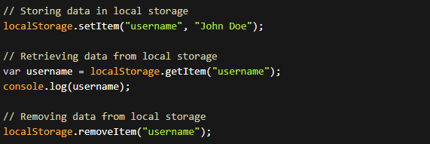
Local & session Storage
Local Storage and Session Storage are two other mechanisms provided by browsers for storing data on the client-side. They offer more storage capacity compared to cookies and provide a simpler API for managing data.
Local Storage:
Local Storage provides a persistent storage area that remains even after the browser is closed and reopened. The stored data is available across multiple browser sessions.

Slide 13
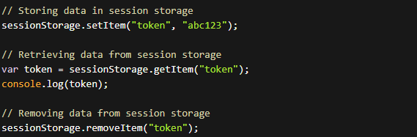
Local & session Storage
Session Storage:
Session Storage, on the other hand, provides a storage area tied to a specific browser session. The data stored in session storage is available only within that session and is cleared when the browser or tab is closed.

Slide 14
Difference between Cookies, Local Storage, and Session Storage
Storage Capacity:
Cookies: Limited to 4KB of data.
Local Storage and Session Storage: Can store larger amounts of data, typically around 5MB.
Expiration:
Cookies: Can have an expiration date set. If not specified, they are considered session cookies and are deleted when the browser is closed.
Local Storage: Data persists indefinitely until explicitly cleared by the user or the application.
Session Storage: Data is cleared when the browser or tab is closed.
Automatic Sending:
Cookies: Sent with every HTTP request to the same domain.
Local Storage and Session Storage: Not automatically sent with HTTP requests.
Accessibility:
Cookies: Can be accessed by both the server and client-side JavaScript.
Local Storage and Session Storage: Accessed only by client-side JavaScript.

Slide 15
Difference between Cookies, Local Storage, and Session Storage
Cookies, Local Storage, and Session Storage serve different purposes based on their characteristics and usage scenarios. Cookies are often used for storing small amounts of data that need to be sent to the server with each request, while Local Storage and Session Storage are suitable for client-side data storage with larger capacity and persistence requirements.

Slide 16
Thanks!
Do you have any questions?
asmaaahmed23762@gmail.com

